Slide 1
MODULE 04:
PRINCIPLES AND APPLICATION OF TACTICAL FIELD CARE (TFC)
TCCC TIER 1
All Service Members
TCCC TIER 2
Combat Lifesaver
TCCC TIER 3
Combat Medic/Corpsman
TCCC TIER 4
Combat Paramedic/Provider

Slide 2




TACTICAL COMBAT CASUALTY CARE (TCCC) ROLE-BASED TRAINING SPECTRUM
ROLE 1 CARE
NONMEDICAL PERSONNEL
MEDICAL PERSONNEL
ASM
CMC
CPP
CLS
YOU ARE HERE
STANDARDIZED JOINT CURRICULUM
2

Slide 3





TERMINAL LEARNING OBJECTIVE
STUDENT LEARNING OBJECTIVES
05
Given a combat or noncombat scenario, perform Tactical Field Care in accordance with CoTCCC Guidelines
23
24
Identify the importance of security and safety in Tactical Field Care (TFC)
Identify basic principles of removal/extraction of casualties from a unit-specific platform
Identify the importance and techniques of communicating casualty information with unit tactical leadership and/or medical personnel
26 Identify the relevant tactical and casualty data involved in communicating casualty information
Demonstrate communication of casualty information to tactical leadership and/or medical personnel (in accordance with Service and/or unit standard operating procedures in TFC)
Identify triage considerations in TFC
25
27
28
6
ENABLING LEARNING OBJECTIVES (ELOs)
= Cognitive ELOs
= Performance ELOs
3

Slide 4


Three PHASES of TCCC
1
CARE UNDER FIRE
RETURN FIRE AND TAKE COVER
TACTICAL FIELD CARE
COVER AND CONCEALMENT
₃ TACTICAL EVACUATION CARE
More deliberate assessment and treatment of unrecognized
life-threatening injuries
▪ Pre-evacuation procedures
▪ Continuation of documentation
NOTE: This is covered in more advanced TCCC training!
2
Quick decision-making:
Basic management plan:
Consider scene safety
Identify and control life- threatening bleeding
Move casualty to safety
Maintain tactical situational awareness
Triage casualties as required
Conduct a MARCH-PAWS
assessment
▪
▪
YOU ARE HERE
4
#TCCC-CLS-PPT-04 30 JUN 20

Slide 5

CASUALTY AND RESPONDER NO LONGER UNDER EFFECTIVE ENEMY FIRE OR THREAT
ENTER INTO THE TACTICAL FIELD CARE
(TFC) PHASE

Slide 6


TACTICAL FIELD CARE
PHASE 2: TACTICAL FIELD CARE
TFC IS CARE RENDERED WHEN NO LONGER UNDER EFFECTIVE ENEMY FIRE OR THREAT
Having transitioned from
Care Under Fire (CUF), further
assessment and care can be more deliberate following the MARCH PAWS sequence
IMPORTANT CONSIDERATIONS:
This does NOT mean that the danger is over – the tactical situation could change back to CUF AT ANY TIME
Mission personnel should constantly maintain their situational awareness of the potential threat from hostile forces
Tactical Field Care also encompasses combat/tactical environment not involving enemy fire (e.g., parachute injury in combat zone)

Slide 7
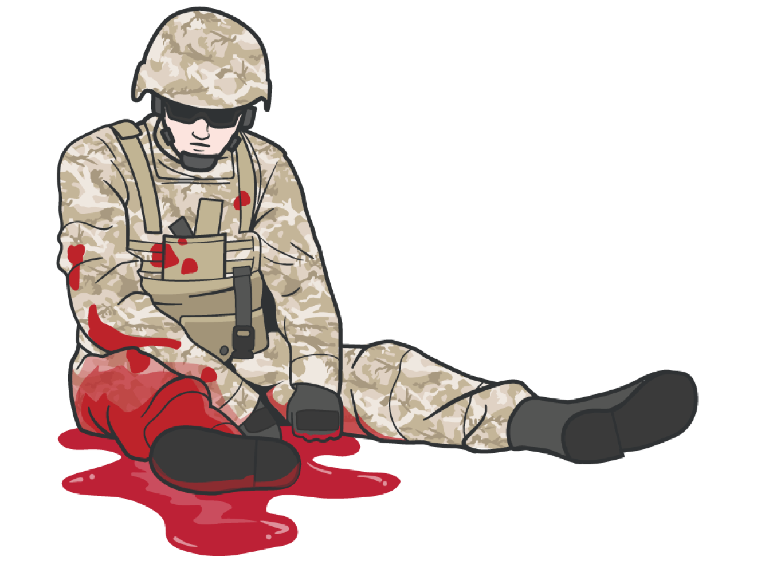
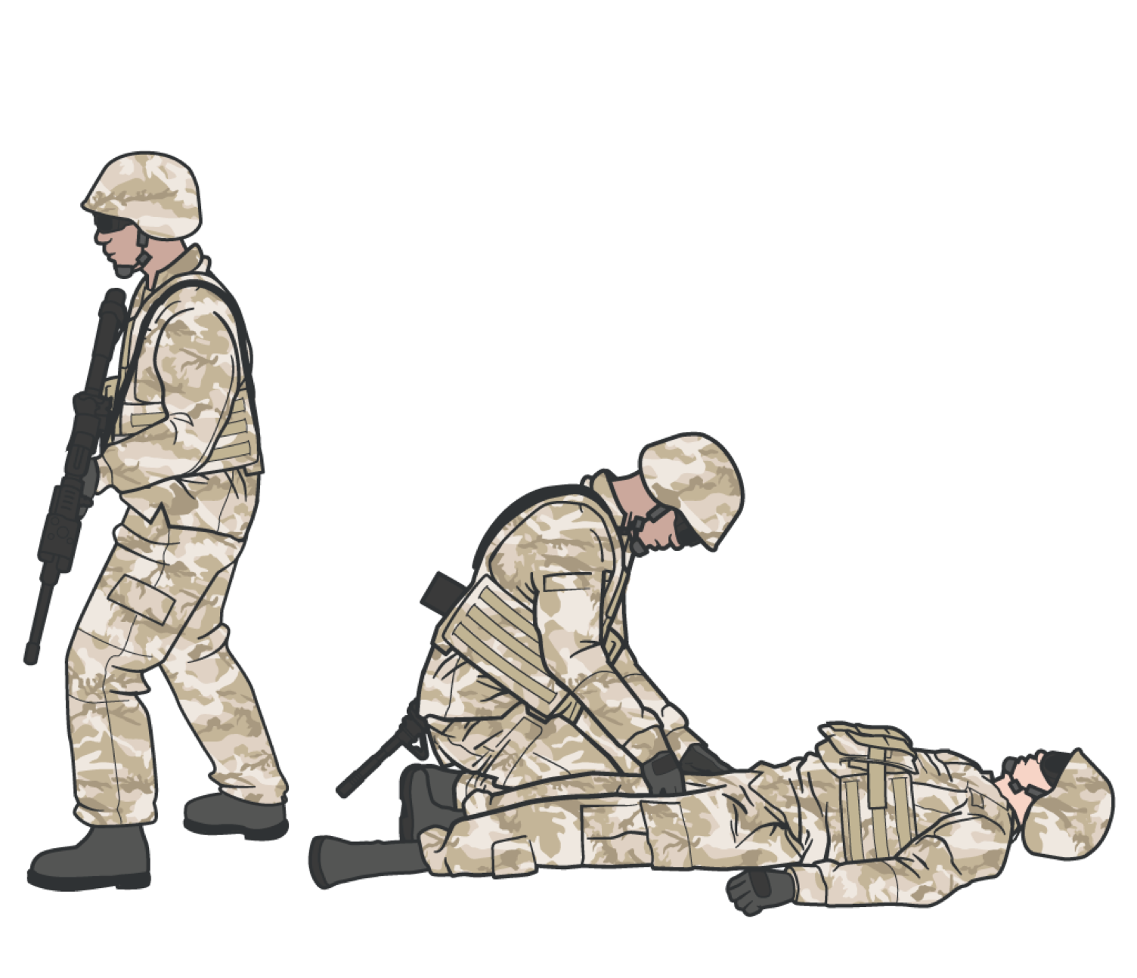


TACTICAL FIELD CARE
SECURITY AND SAFETY IN TACTICAL FIELD CARE
Establish a security perimeter
CASUALTIES WITH ALTERED MENTAL STATUS SHOULD HAVE
Weapons cleared and secured
in accordance with unit tactical standard operating procedures and/or battle drills
Maintain tactical situational
awareness
Communications secured
Sensitive items redistributed
Weapons and radios DO NOT
mix well with shock or narcotics

Slide 8
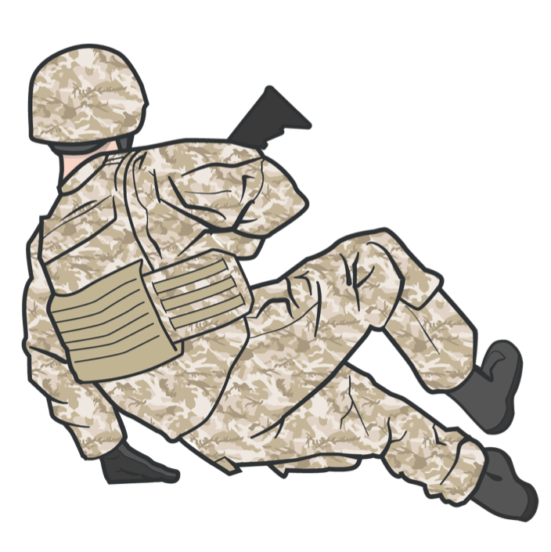


TACTICAL FIELD CARE
OTHER CONSIDERATIONS
REMEMBER:
Always use the casualty's
JFAK FIRST
TFC can turn into a CUF situation unexpectedly
Personnel should maintain their situational awareness
TFC is when the casualty and
LIMITED SUPPLIES
Medical equipment and supplies
the person rendering care are
NOT under direct fire
are LIMITED to what is carried into the field by the combat lifesaver and the individual service member

Slide 9
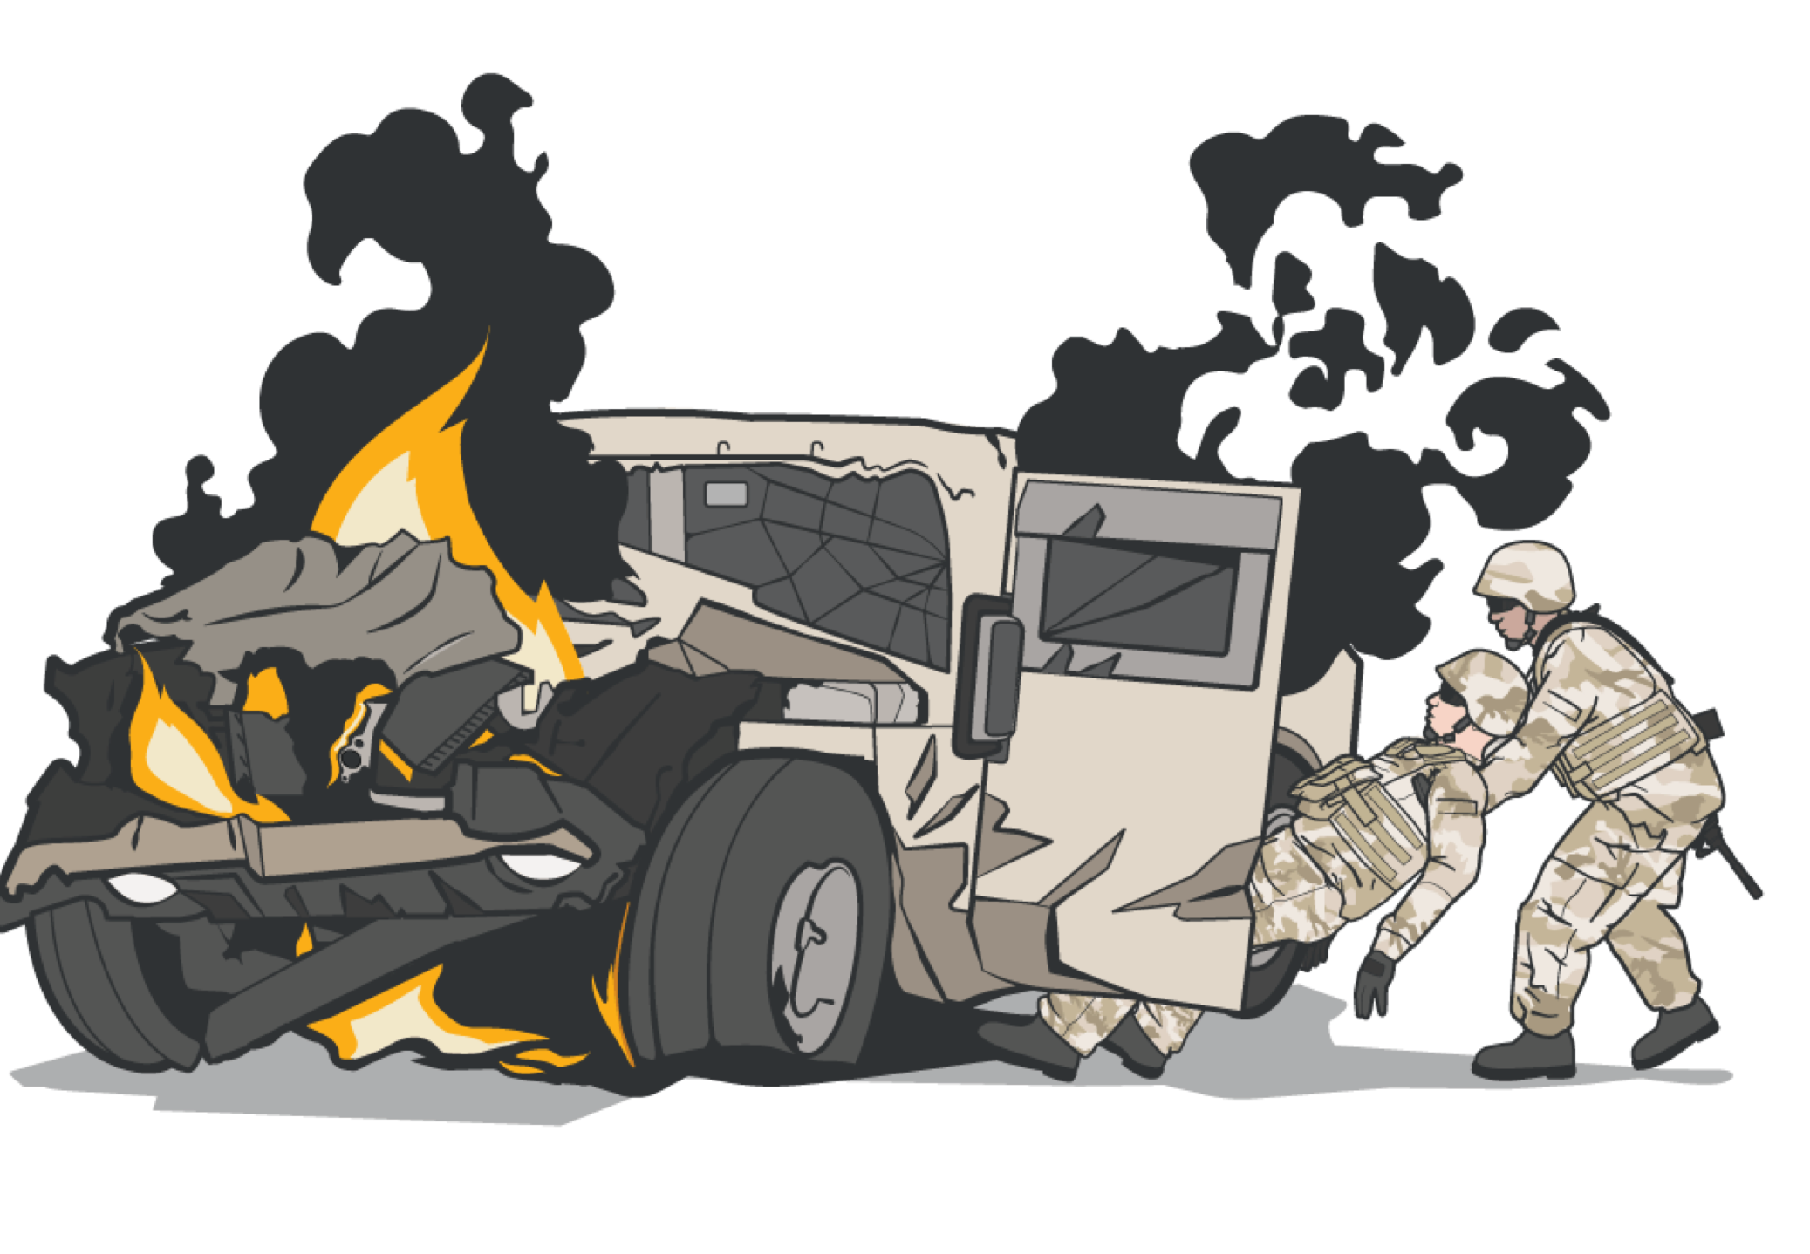
TACTICAL FIELD CARE
CASUALTY REMOVAL/EXTRACTION PRINCIPLES
The first principle is safety. Safety is critical.
The second principle of MARCH still applies. If possible, you may want to initiate lifesaving measures like applying a tourniquet before the extraction, and monitor them throughout the process.
The third principle is training.
Extractions will vary based on the mission and vehicles located in your Area of Responsibility (AOR)
S

Slide 10




MARCH PAWS
TACTICAL FIELD CARE
DURING LIFE-THREATENING AFTER LIFE-THREATENING
M A R C H
MASSIVE BLEEDING
#1 Priority
PAIN
AIRWAY
ANTIBIOTICS
RESPIRATION (breathing)
WOUNDS
CIRCULATION
SPLINTING
HYPOTHERMIA/ HEAD INJURIES
#TCCC-CLS-PPT-04 30 JUN 20

Slide 11
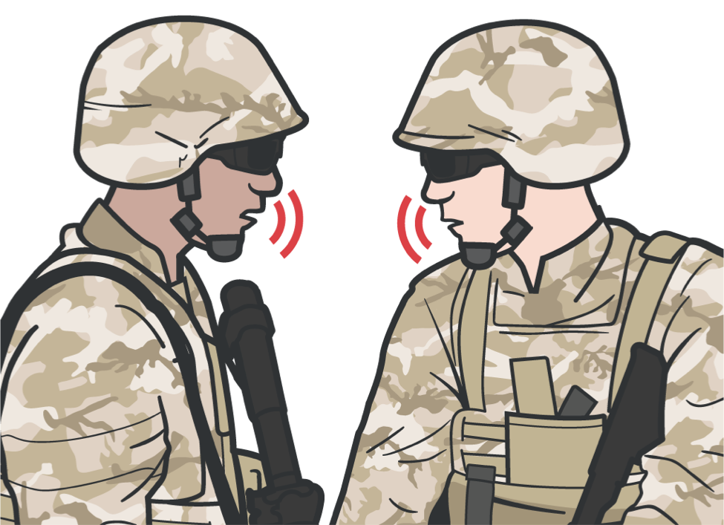

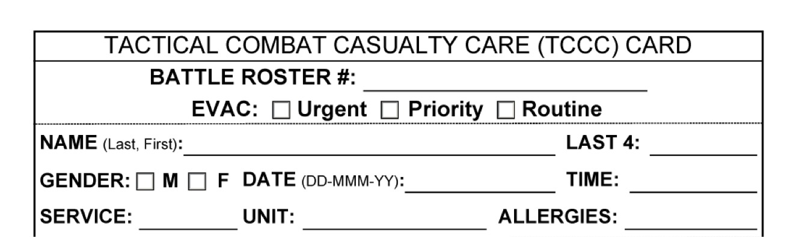
TACTICAL FIELD CARE
COMMUNICATION
COMMUNICATE WITH EVACUATION AND MEDICAL ASSETS
Communicate with the evacuation system to coordinate TACEVAC/MEDEVAC using the 9-Line MEDEVAC request
Keep each casualty's DD Form 1380 up to date
Communicate with the casualty, if possible
Communicate with tactical
leadership IMMEDIATELY on evacuation requirements
Encourage
Reassure
Continue to communicate with
Explain care each step of
leadership on casualty treatment as needed
the way

Slide 12
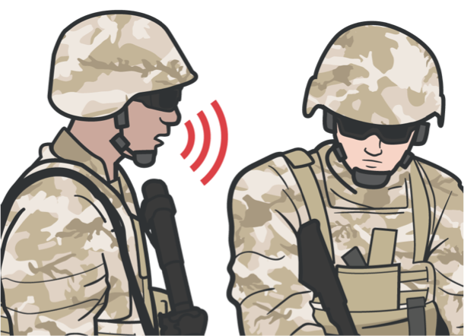
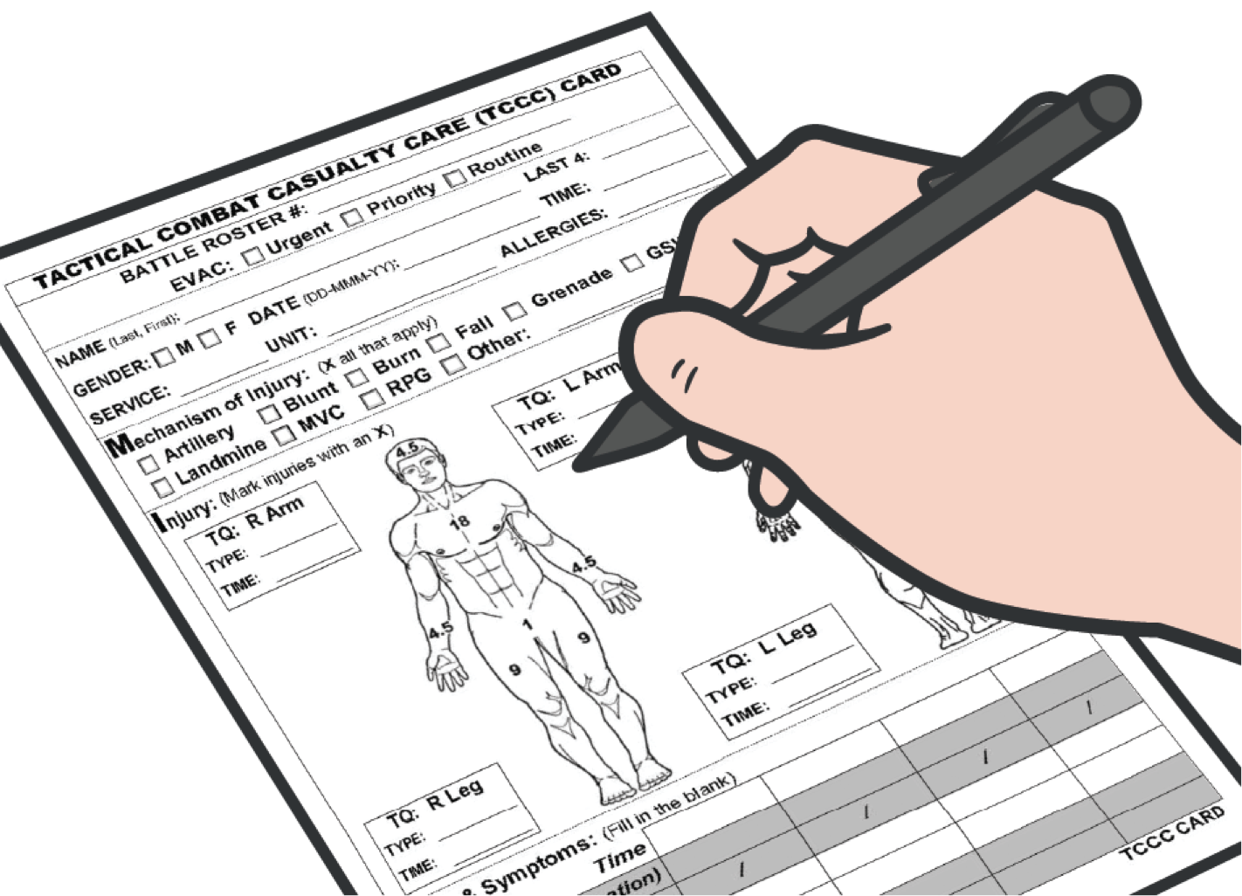
TACTICAL FIELD CARE
COMMUNICATE RELEVANT CASUALTY DATA
COMMUNICATE CASUALTY DATA IN HAND-OFF WITH MEDIC OR MEDEVAC
Communicate with MEDEVAC using the:
When handing casualty off
to medic or MEDEVAC, read off the DD Form 1380, including any additional information as needed
9-Line MEDEVAC request form
MIST Report
Mechanism of injury
Injuries Symptoms Treatment
Relay the information following your standard operating procedures
MIST report may change
as the casualty status and interventions performed change
Document ALL assessment and medical care (including interventions and medications) on the DD Form 1380

Slide 13
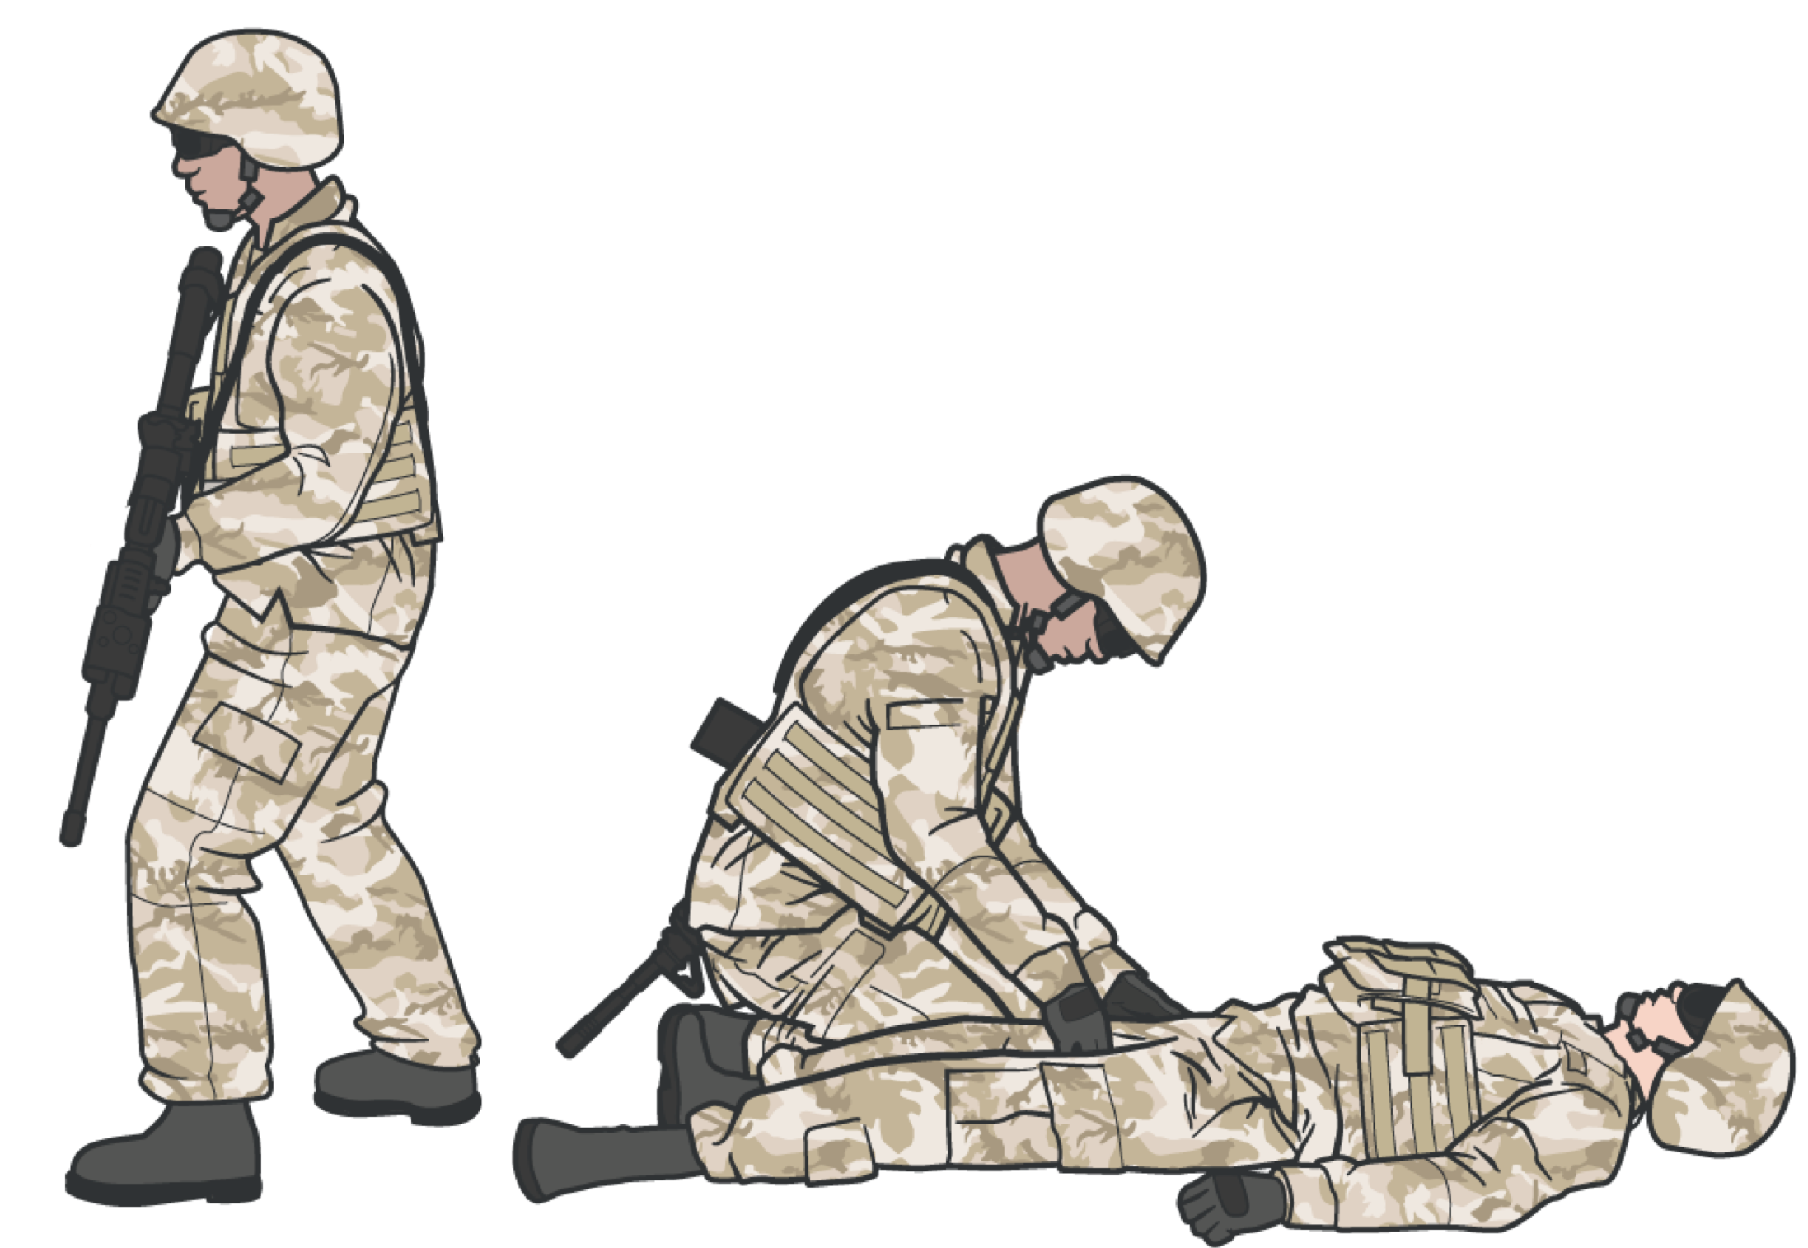
TRIAGE ‒ PRIORITIZING MULTIPLE CASUALTIES
TACTICAL FIELD CARE
Casualties with these injuries must be treated first:
#1 Massive bleeding
#2 Penetrating trauma into the box (torso) #3 Airway compromise
#4 Respiratory distress #5 Altered mental status

Slide 14
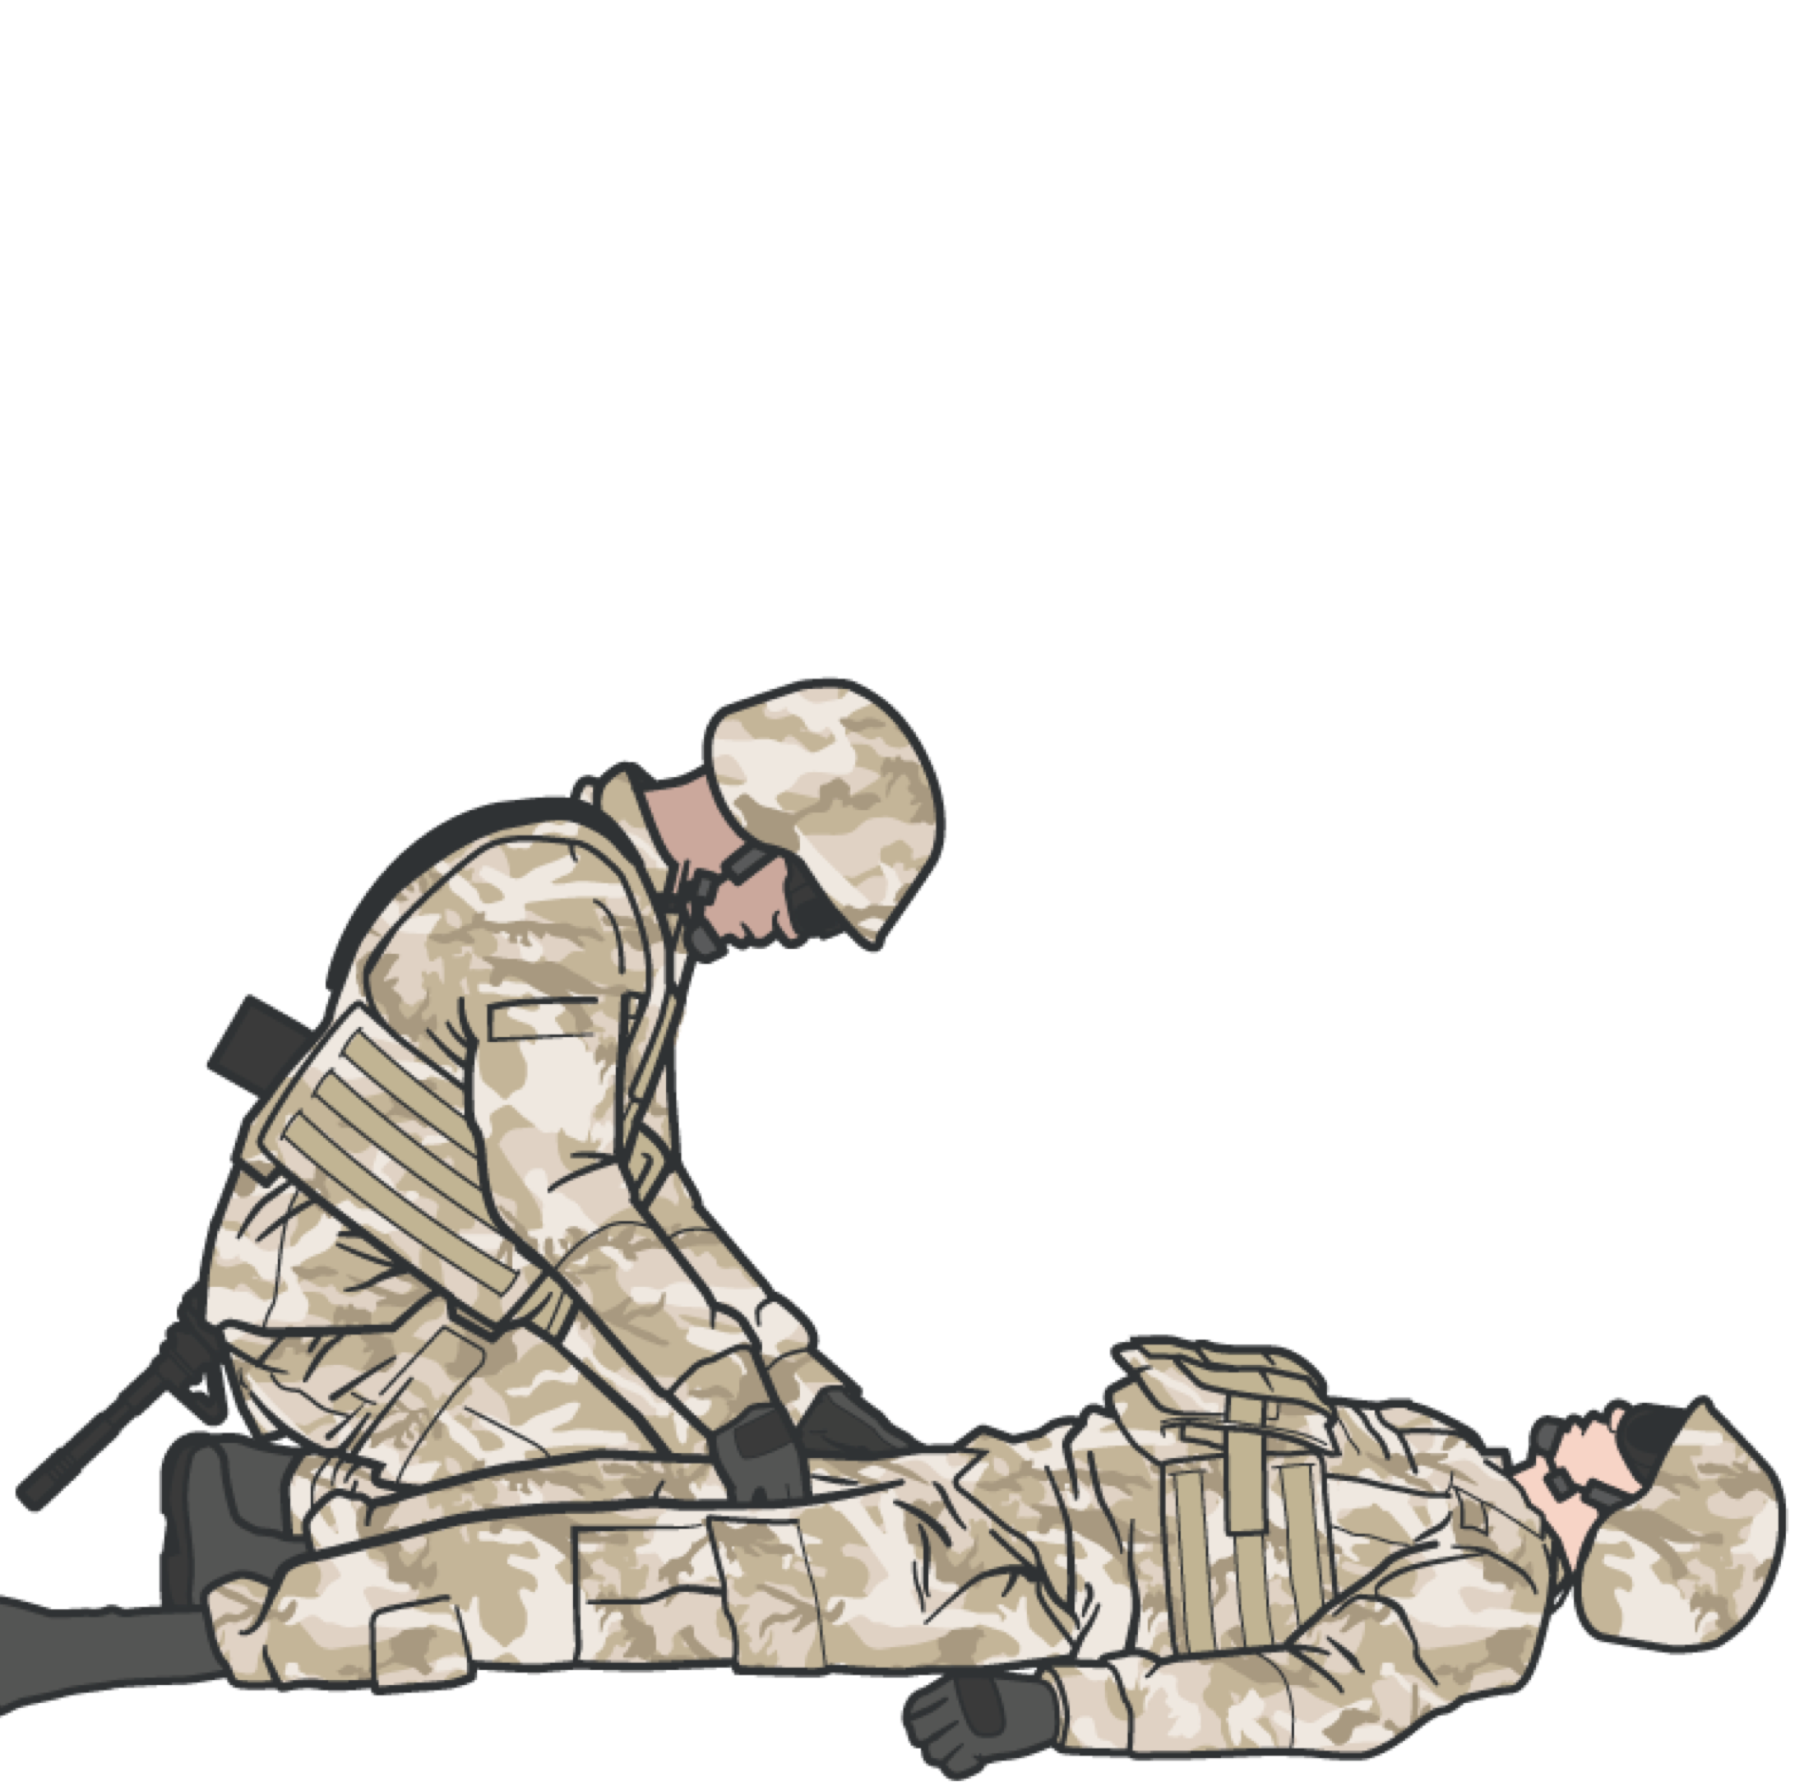
TACTICAL FIELD CARE
TRIAGE CONSIDERATIONS
Casualties may need to be sorted into prioritized treatment groups
The CLS may be required to assist medical personnel with urgent casualties, monitor casualties after emergency interventions, and may be tasked with preparing casualties for evacuation

Slide 15
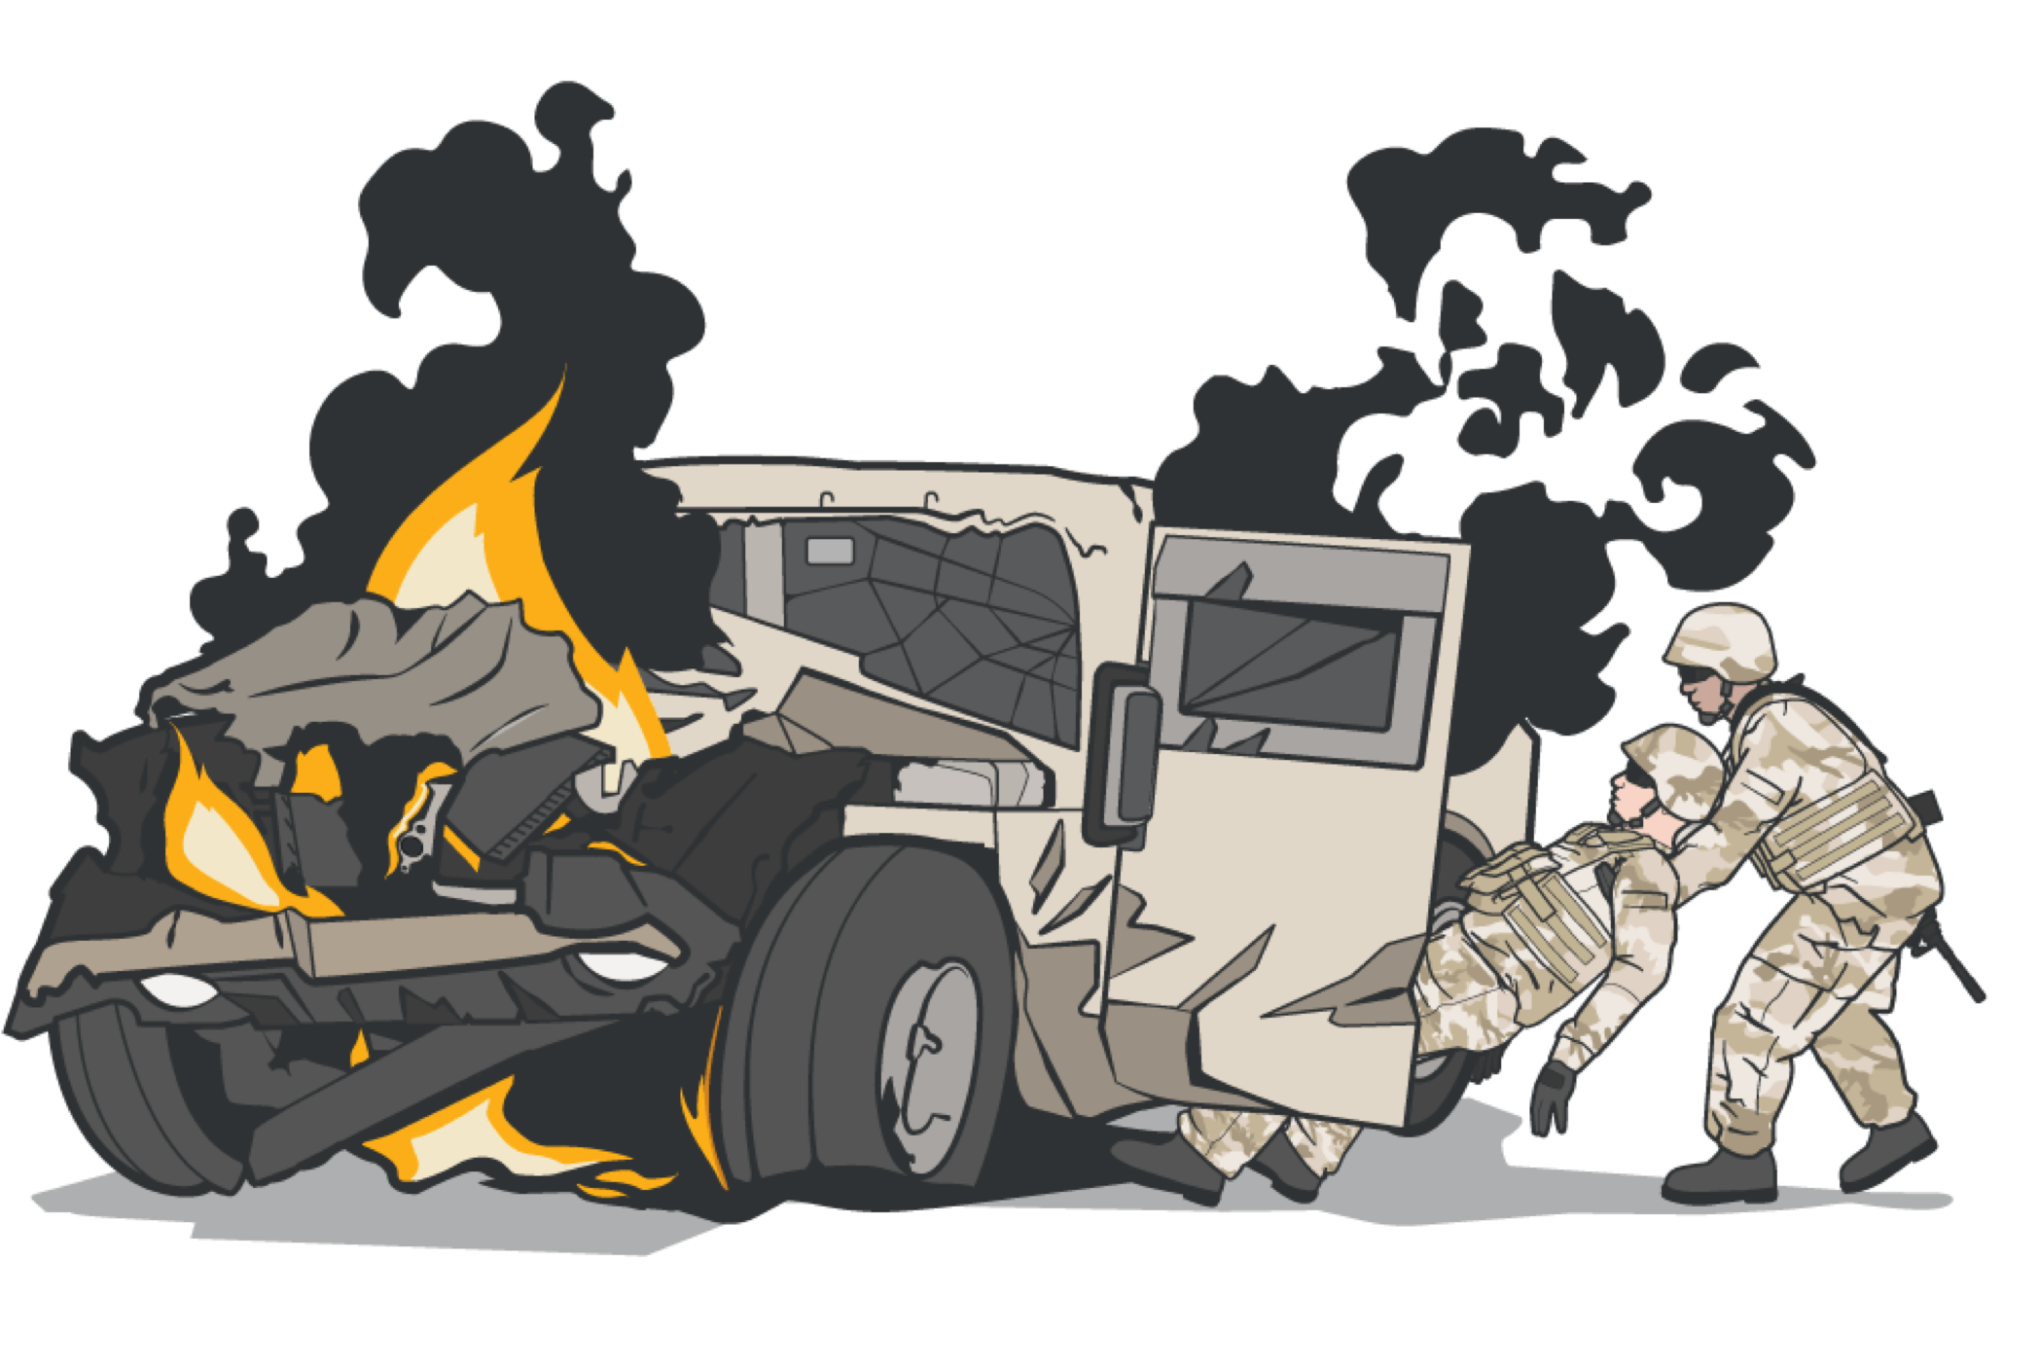
TACTICAL FIELD CARE
SUMMARY
Ensure you are aware of all security and safety procedures for TFC
Tactical Field Care is when the casualty and the responder are both no longer under effective enemy fire or threat
Security and safety in TFC is a priority; clear and secure weapons and communications
Understand the principles of casualty extractions in accordance with unit standard operating procedures
Always follow the MARCH PAWS procedure during life-threatening and after life-threatening injuries

Slide 16
CHECK ON LEARNING
What is the difference between the TFC and CUF phases?
True or False: During TFC, the tactical situation could change back to CUF again at any time.
What is MARCH PAWS?

Slide 17
ANY QUESTIONS?

